Slide 1

Visualizing MultiDisciplinary Research
Members :-
Akshay Dangare
Ankita VK
Vipluv Mittal

Slide 2
What is multidisciplinary research ?

Slide 3
Tools and Case studies used for Visualizing Multidisciplinary Research

Slide 4
Nar-a-Viz Tool
Chronological Narrative Clustering
Semantic Narrative Clustering
Topic based Clustering

Slide 5
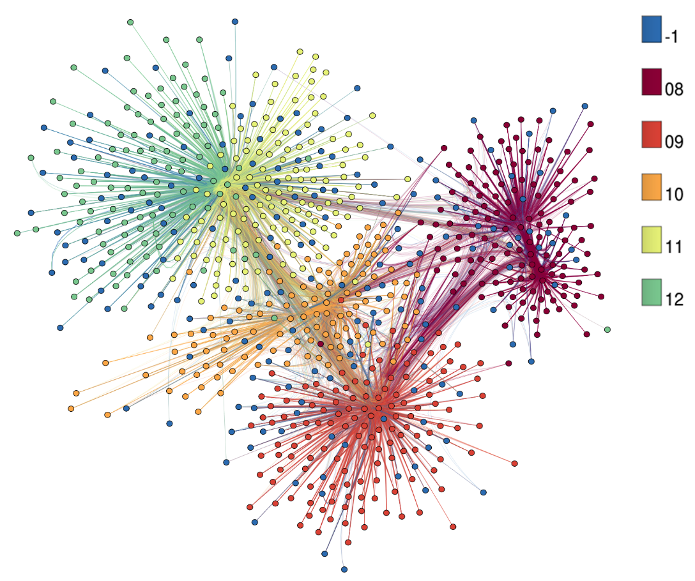
Publication Network Tool

Slide 6
What if …

Slide 7

The IDEA.

Slide 8
“ An idealistic approach” to Visualize Multidisciplinary Research.

Slide 9
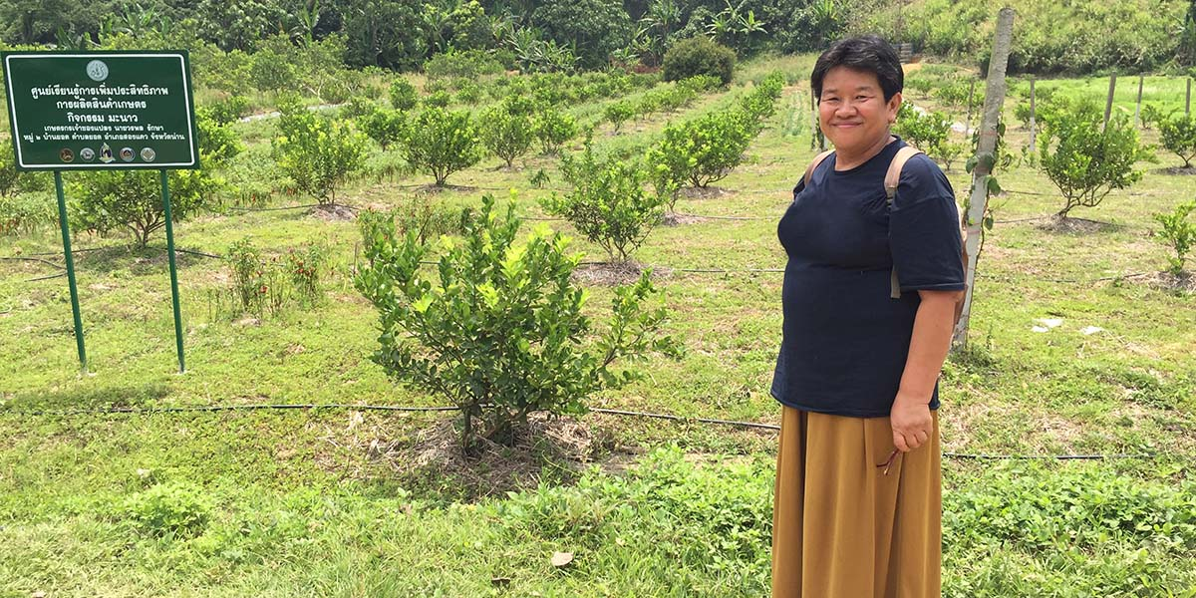
“Creative tourism”: A case study

Slide 10
Project Pipeline.
The user selects the list of topics/research domains/products.
Our tool finds the general theme.
Web crawler- Scraps all the relevant data from the web.
Cleaning of data.
Based on the results generated by the web crawler, our tool decides the ideal and important parameters and features.
It plots an ideal reference frame which includes the ideal features.
Visualises the users topics/domains/products against the reference frame.
See the comparison and make a decision.

Slide 11

Conclusion.
“ Ask youself - How Does what I see, come to be seen by me ? ”
- Edward Tufte

